Slide 1
How it works
Assemble the device
Attatch the transducer
Configure the msp430 to accept frequencies, to place in the memory map.

Slide 2
Objective
Design a data transfer device that will provide a test signal, for the purpose of evaluating consumable liquid.
The device will transmit updated information without using invasive techniques that could risk contamination. The frequency will measure the electrical signatures of ions within the tested liquid, providing a reflected impedance for analysis.
The device should be adjustable for the intended frequency range of the ultrasonic transducer for sensors testing range meaning it will store information data remote and locally.
The device should be able to evaluate if the milk is consumable.
The device should employ the sensor to a surface area, in turn the device will provide a signal if the impedance is not consumable. During this project a goal is to be able to find a viable way to transmit food data using ultrasonic sound waves across any thin, transparent barrier of liquid.
Need
Milk allergy can cause anaphylaxis, which is a reaction that narrows the airways and can block breathing.
Milk is the third most common food after peanuts and tree nuts, which cause anaphylaxis.
This design aims to assist in how clean a product can be.
Our design would boost the confidence of consumption from smaller grocery stores.
food products creating a sustained culture of selling edible products.

Slide 3
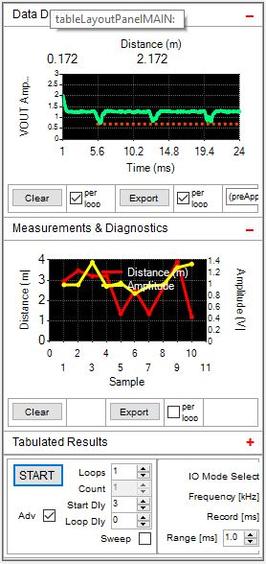
Milk
Notes:
Milk, we could verify that the time of flight within several samples of refrigerated milk, 3 different brands. were 0.5
However the results would be better if there was time, as in two weeks, when the signs of coagulation, aging, transfer of state from ion to essentially bacteria for our purposes.
This would give proof that our device does detect state change.

Slide 4
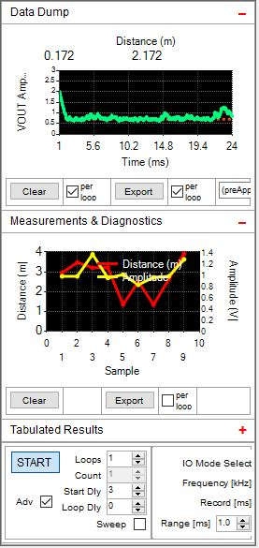
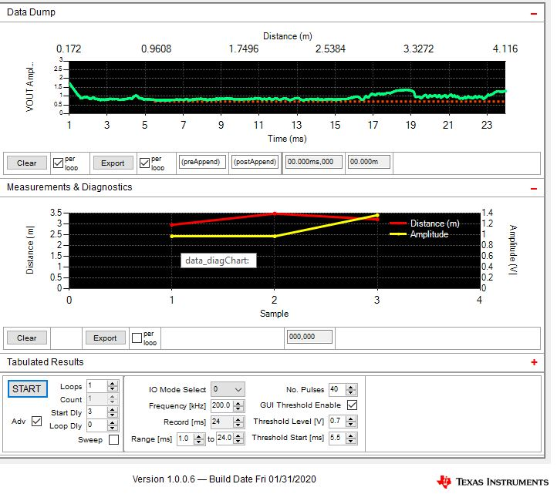
Water
Notes:
In order to differentiate here on the left is purified tap water, on the right is Nestle water. This intended to make up for the time it would take for our milk to age to detect particle change within the untampered with milk.
As you can see from the Amplitudes on the device sampling at a frequency of 200KHz

Slide 5
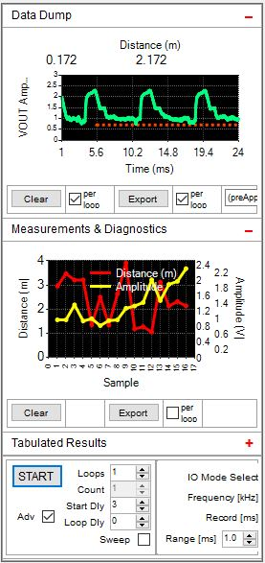
Gatorade
Notes:
With an amplitude of 2.5 voltage reading, you can see the gatorades TOF of the test signal. In our testing, after testing if the container made a difference in our testing. I was able to verify that the readings of reverberations within the liquid would be affected, however, by a difference only in amplitude, not pattern.
This added to the questions that could be later improved, when analyzing the shortcomings of our device. An improvements that could be made to our device would be to figure out what kind of pattern would classify the reading as bad in the Data dump.
In our research, there is no standard definition on what measurment frequency is considered consumable.

Slide 6
Conclusion
Learned about time of flight and the ability to detect conductivity.
The device was not able to conclusively verify a whether any of the tested liquids were bad, by our definition. However the device was able to verify accurately between three test, a general range between 0.5% of a sample.
Improvements (See Code Implementation)
Through further analysis, this device can be optimized to save the results.
The device depending on the background does depend on the container that is housing the liquid.
As well, there needs to be a GUI that is added to the Texas Instruments packaging, that analyzes the results.
Notes:
When changing the color of the background, the measurements would marginally change, however it was enough to create a uniform background for each product that would be tested. Ensuring that the transducer would be fixed to the side of the container, the measurements were able to verify the first two metrics in the acceptance test.
The third acceptance test was not verifiable as the technology was not robust enough to communicate with other devices without being tethered.

